Slide 1
ADVENTURE WORKS PROJECT – P74
GROUP NO – 5TH
MENTOR – MOHAMMAD ARIF
GROUP MEMBERS -
MR. PANKAJ GUPTA
MR.RAJESH MUKUND BHARATI
MR. ANIKET VINAYAK JADHAV
MR.SHUBHAM ANIL PATIL

Slide 2
ADVENTURE WORKS PROJECT
INTRODUCTION : -
Adventure Works Cycles, the company on which the Adventure Works sample databases are based, is a large, multinational manufacturing company. The company manufactures and sells metal and composite bicycles to North American, European and Asian commercial markets. While its base operation is in Bothell, Washington with 290 employees, several regional sales teams are located throughout their market base.
In 2000s, Adventure Works Cycles bought a small manufacturing plant in Mexico. Which manufactures several critical subcomponents for the Adventure Works Cycles product line. These subcomponents are shipped to the Bothell location for final product assembly. In 2001, this manufacturing plant became the sole manufacturer and distributor of the touring bicycle product group.
Coming off a successful fiscal year, Adventure Works Cycles is looking to broaden its market share by targeting their sales to their best customers, extending their product availability through an external Web site, and reducing their cost of sales through lower production costs.

Slide 3
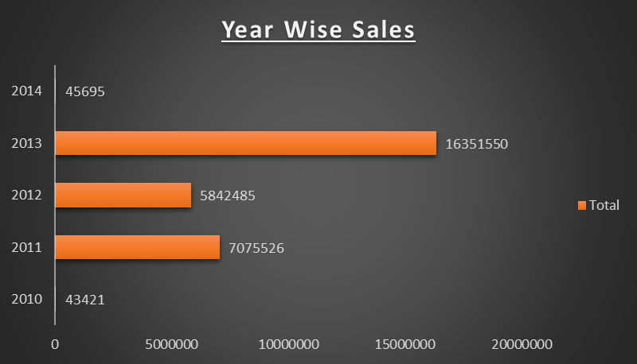
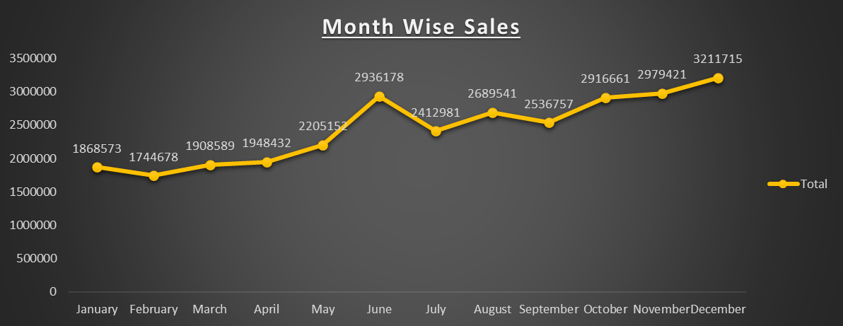
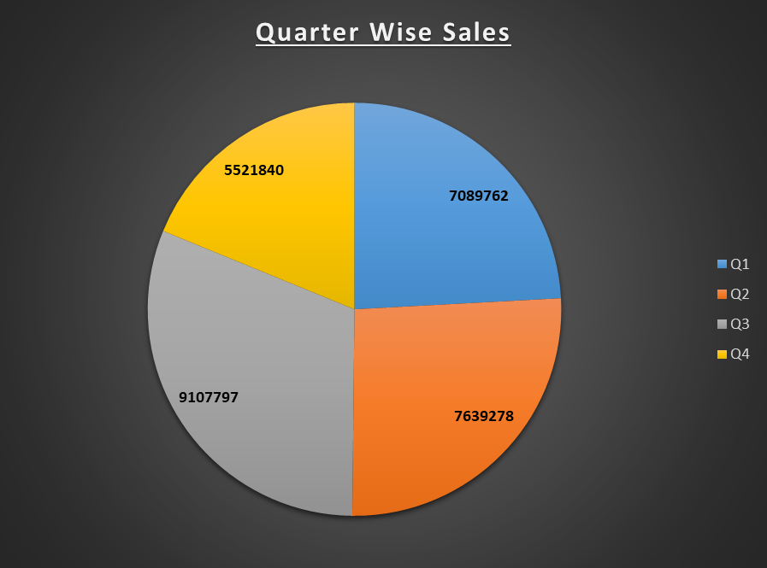
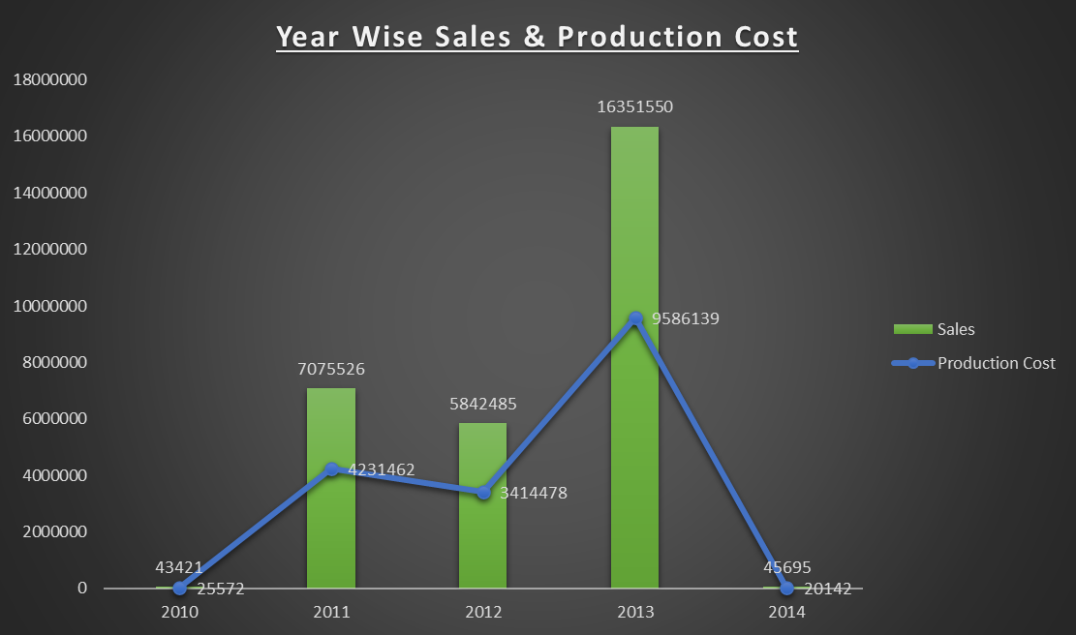
EXCEL WORK ( DASHBOARD)

Slide 4
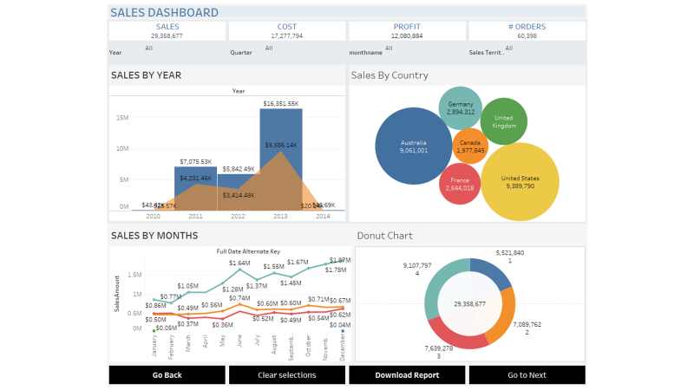

TABLEAU DASHBOARD

Slide 5
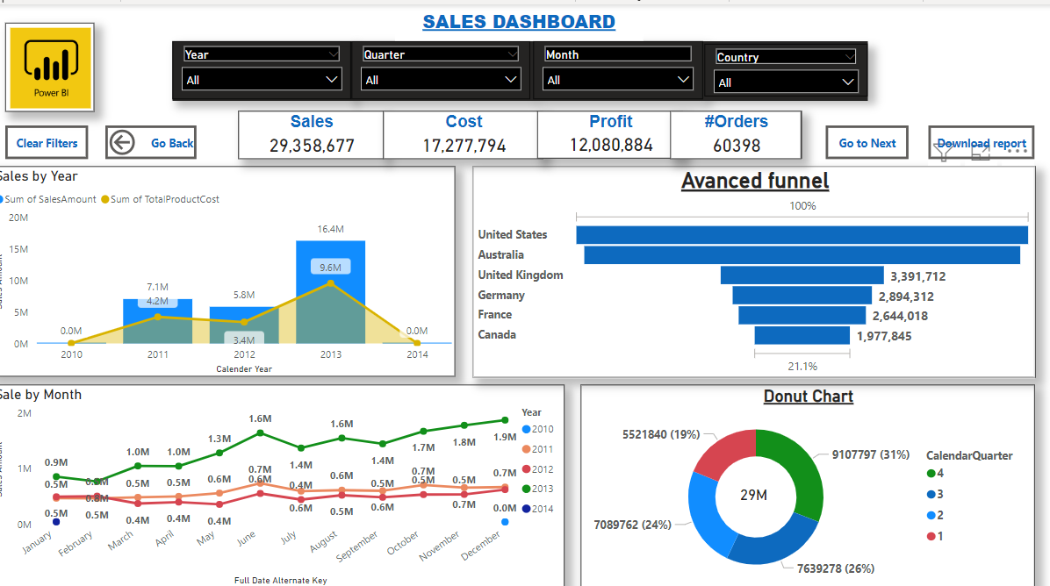
POWERBI KPI AND DASHBOARD

Slide 6
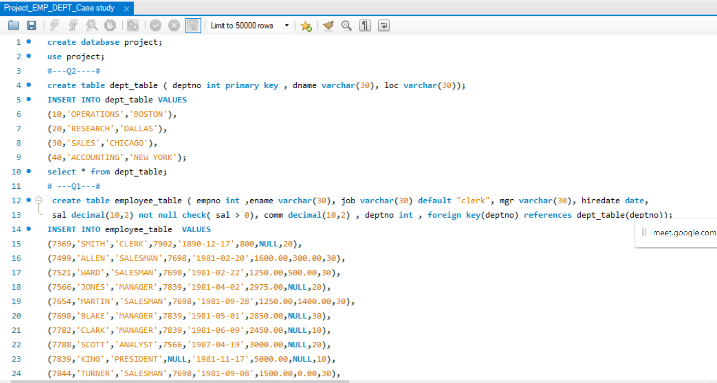
SQL EMP_DEPT QUERIES AND OUTPUT

Slide 7
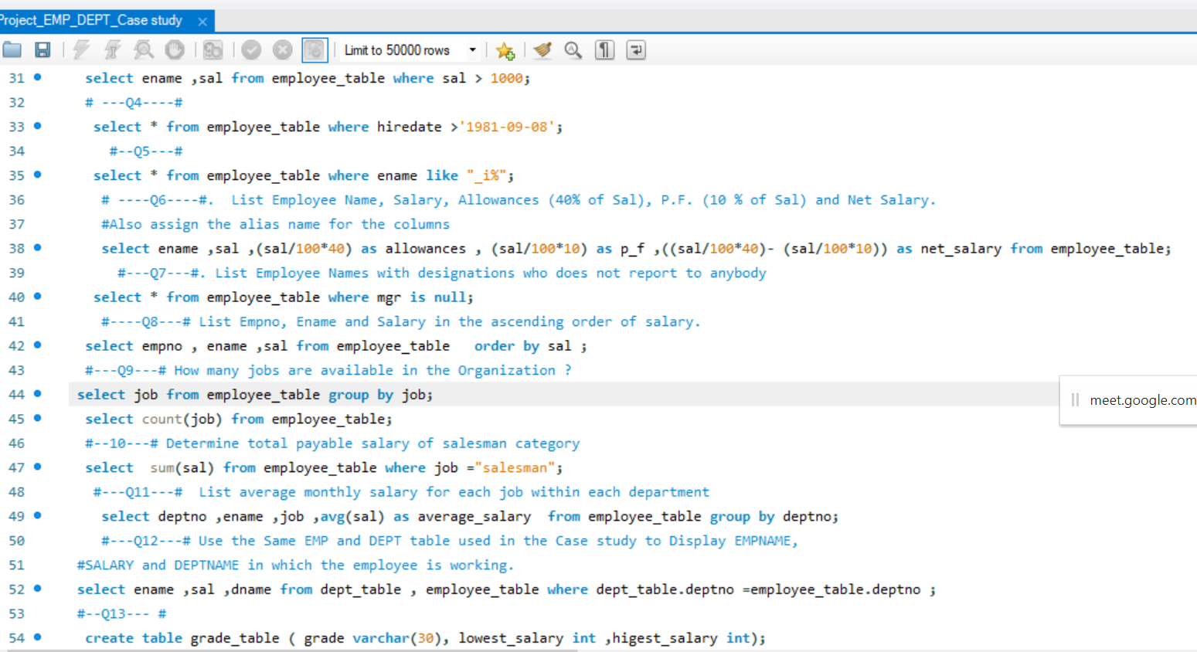

Slide 8
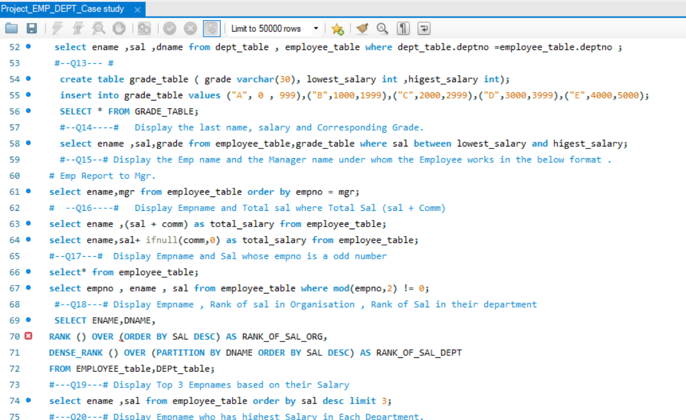

Slide 9
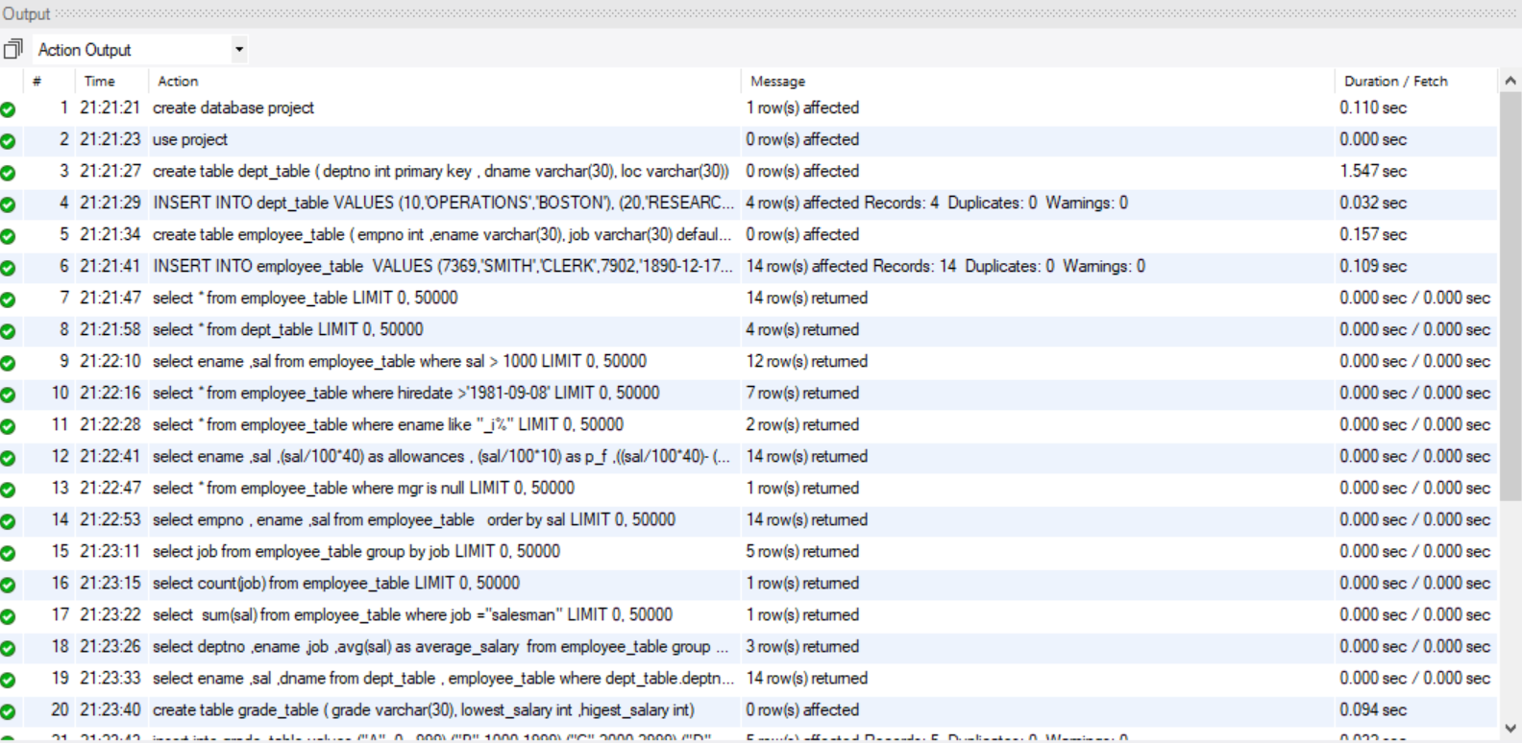
SQL EMP & DEPT ACTION OUTPUT

Slide 10
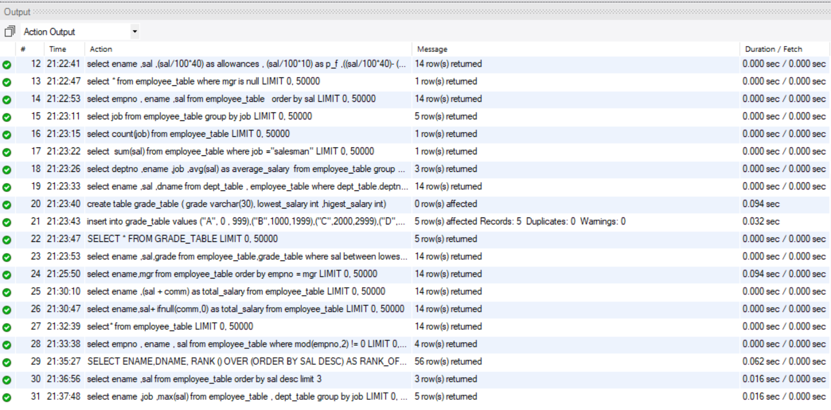

Slide 11
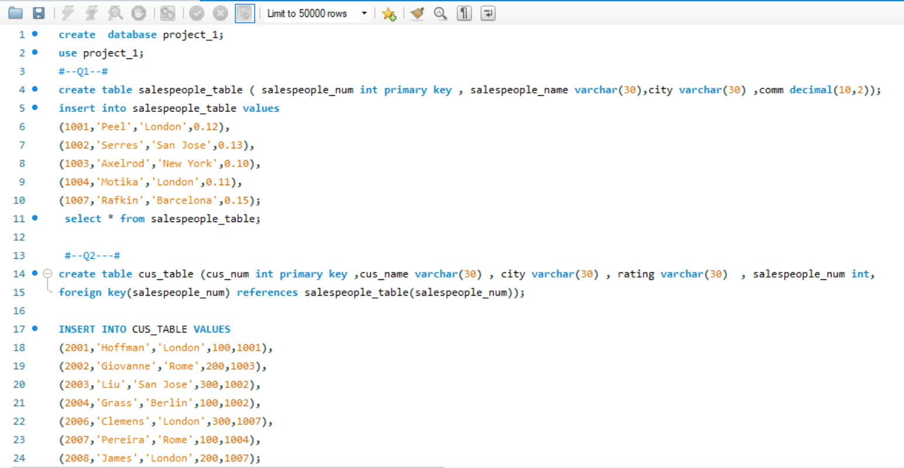
SQL SALESPEOPLE, ORDER, CUST QUERIES AND OUTPUT

Slide 12
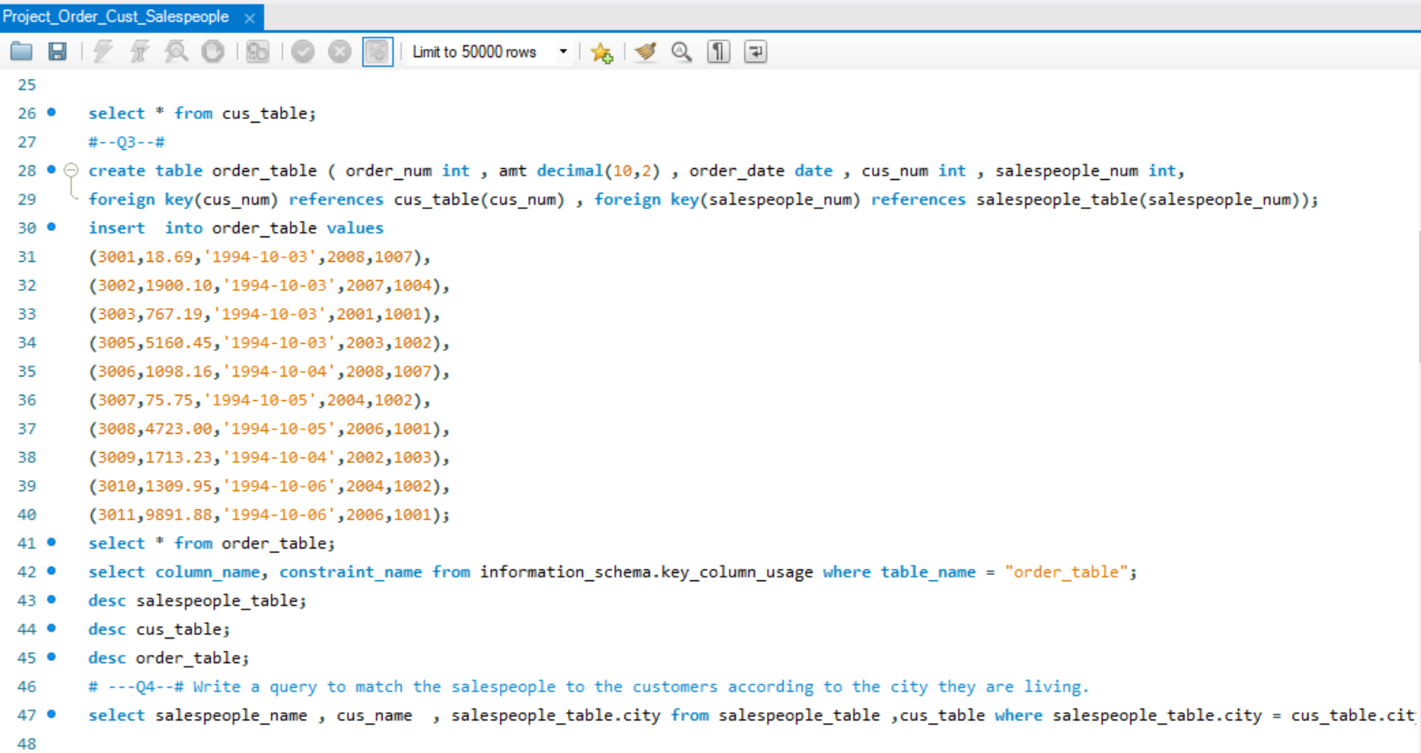

Slide 13
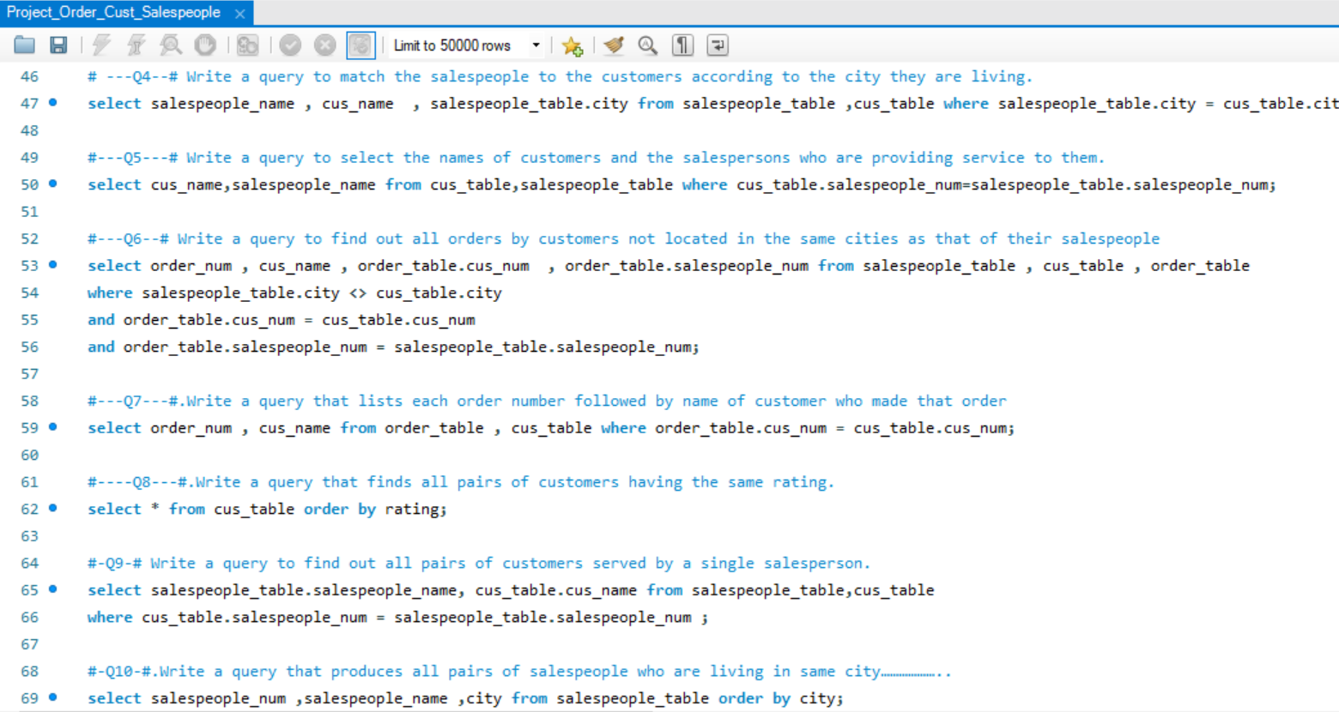

Slide 14
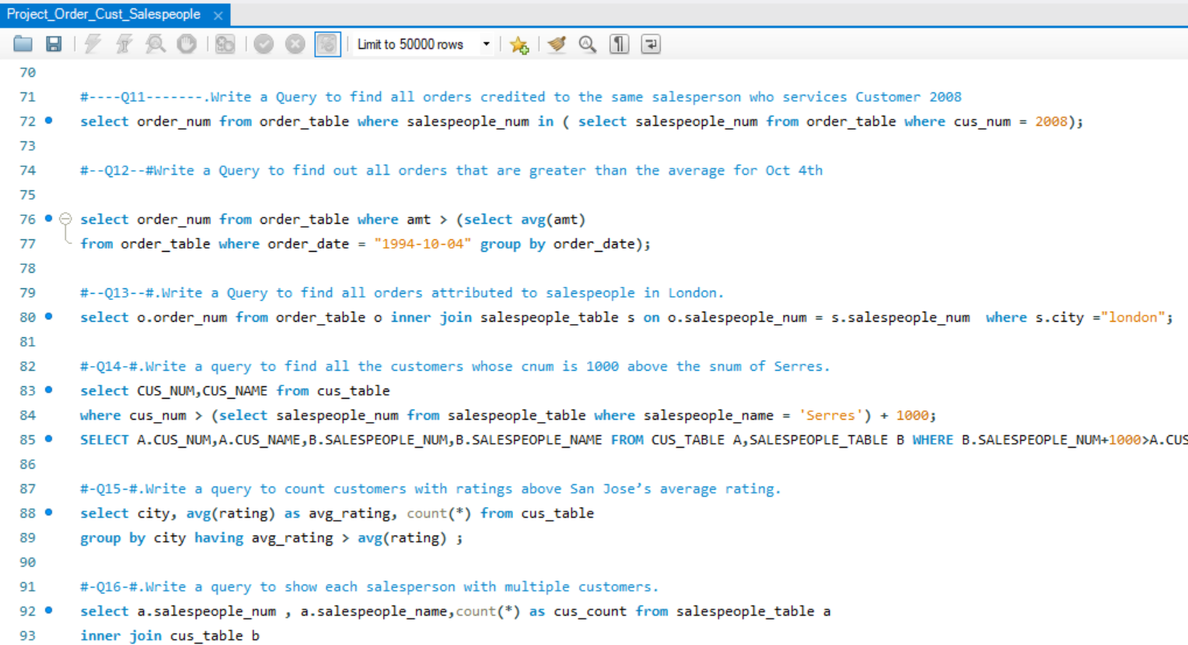

Slide 15
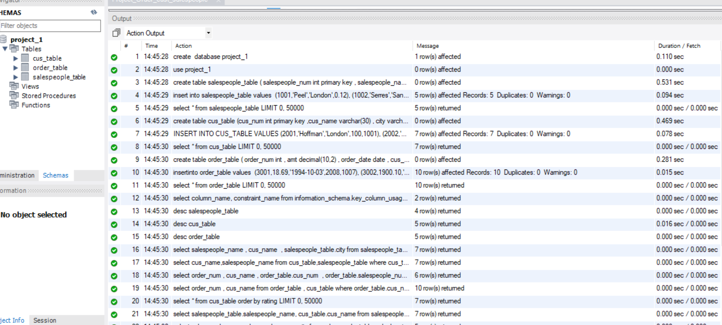
ACTION OUTPUT OF SALESPEOPLE, CUST, ORDER TABLES

Slide 16
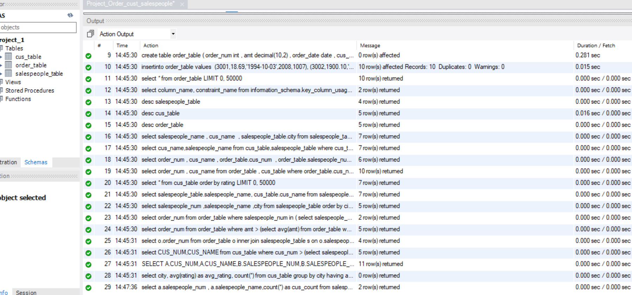

Slide 17
THANK YOU

